Slide 1






Computer Graphics
Project
ATOM SIMULATION
DEPARTMENT OF COMPUTER SCIENCE
AND ENGINEERING
Under The Guidence
AYESHA SHEIKH
4HG20CS001
Miss.Madhuri H D
faculty, Dept.of CSE
BHAGYA RAJU NAIK
4HG21CS403

Slide 2

CONTENT
INTRODUCTION
AIM AND SCOPE
OBJECTIVES
SYSTEM CONFIGURATION
SNAPSHOT
METHODOLGY
ADVANTAGES
CONCLUSION
REFERENCES
1
1

Slide 3
INTRODUCTION
Atom simulation is 2D atom simulator which contains options like selecting the user desired element, simulating the selected element.
User can get to know how an element structure is and how the electrons revolves around the nucleus.
2

Slide 4

AIM AND SCOPE
The aim of this project is to develop a 2-D atom simulator that provide clear picture about the structure of element
It has a huge scope in future as it contains user friendly interface and pictorial representation of molecule structure,revaluation of electrons around neucleas.
3

Slide 5
OBJECTIVES
Atom Visualization
User Interaction
Molecular Dynamic Simulation
performance Optimization
4

Slide 6
SYSTEM CONFIGURATION
SOFTWARE REQUIREMENTS:
Operating System
UNIX
Language Tool
OpenGL
Editor
vi editor or geditor
5

Slide 7
METHODOLGY
Menu bar
Menu bar is designed so that one can easily access the various options like select the elements or starting the simulation or stoping simulations.
Simulation Display:
As soon as user selects the element and click on the simulate option, the electrons around the nucleus starts revolving around the nucleus within their orbit.
8

Slide 8
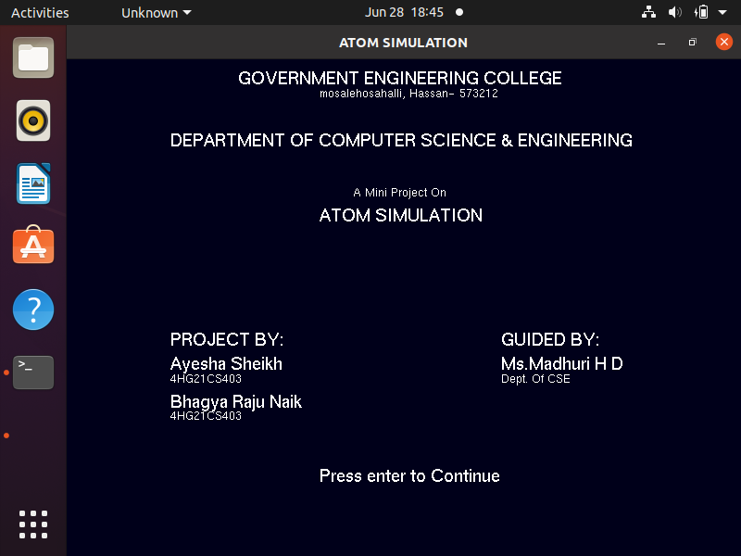
SNAPSHOT
6

Slide 9
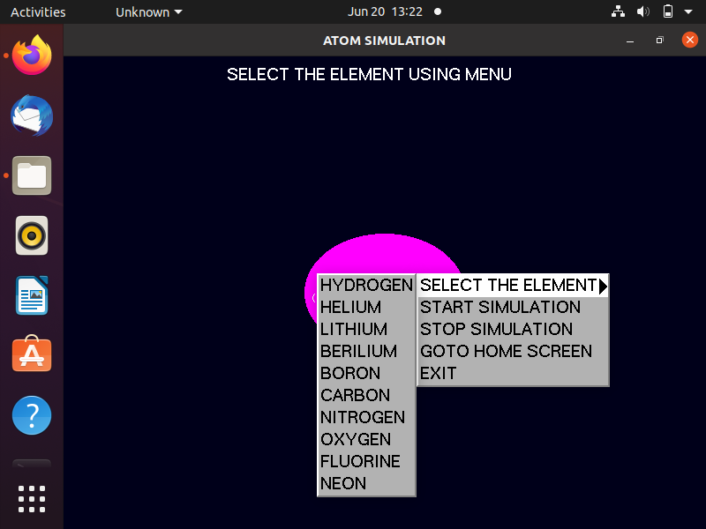
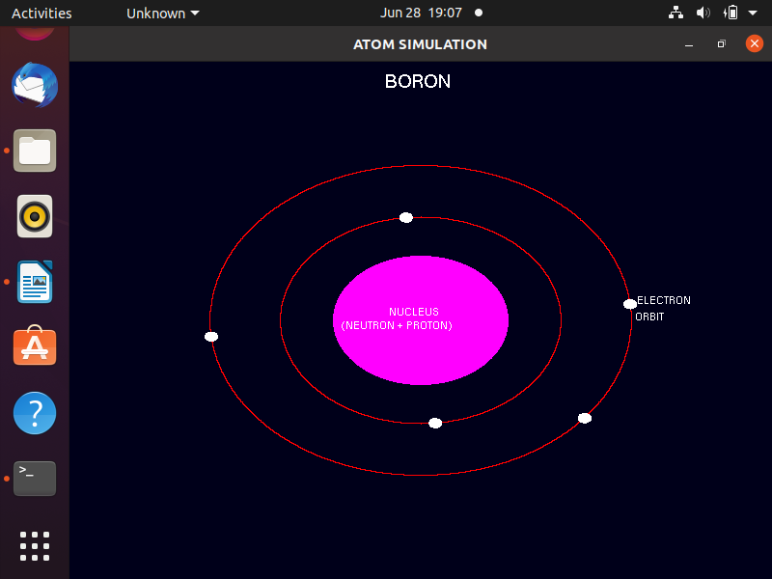
7

Slide 10
CONCLUSION
User can very easily understand the structure of an element. the interface is mouse driven and the user can select a function by clicking and support the keyboard interface.
9

Slide 11
REFERENCES
https://www.researchhate.net
https://www.openglforum.org
https://www.turoriaspoint.com
10

Slide 12


